Slide 1
Prestige Insurance Group: 2024 Strategy

Slide 2
Situation Trigger, Question
Situation
Trigger
Prestige Insurance Group is looking to stay ahead in the competitive landscape through innovation, and overall guide the company's future direction.
A newly obtained dataset by the CEO is believed to hold the answers to current market dynamics to drive revenue and business strategy.
Question
Hypothesis
Can we leverage the dataset to provide preliminary insights & recommendations for the company's future direction?
The dataset alone is not comprehensive enough to fully inform future strategic direction or revenue growth, but will provide a starting point.

Slide 3
Key Recommendations & Insights
Insights
The more renewal transactions a customer has the more likely they are to renew a policy
The contact centre and online channels are the primary method for renewal activity
Brand F & C are the primary GWP contributors
Predicting GWP does not rely on renewed units alone, but due to additional factors
Limitations
The dataset was problematics as it only cover 5 days worth of data for the 2023 July period.
There was not a range of data e.g. claims, complaints information, customer NPS, customer demographics and detailed policy information
Unknown how or why this particular sample of data was collected
Recommendations
A larger dataset, spanning over 3 years would be needed to accurately capture periods throughout the year, and claims events
A more diverse dataset to help depict GWP – there are unknown variables at play
Invest more into consultant - customer conversations, outbound calling at renewal time, smarter customer notifications of renewals to increase review
Build out online platform and capabilities to encourage digital adoption
Consider brand consolidation – focus on brands that are working

Slide 4
Descriptive Statistics
Numerical Data Statistics
Renewal Transactions
Mean: 799
Median: 420
SD: 1,186
Renewed Units
Mean: 371
Median: 53
SD: 743
Gross Written Premium
Mean: $311,757.94
Median: $29,661.20
SD: $676,270.53

Slide 5
Data Approach and Implementation
Missing Values
Detected 3 missing values for Originating Channel
Replaced missing values as UNKNOWN – UNKNOWN was a used variable in the dataset already
UNKNOWN only makes up 3.75% of the dataset
Outliers & Anomalies
Detected 20 negative values for Renewed Units, 2 negative values for GWP, and 1 empty value for GWP
The approach taken to remove all of the negative and 1 empty value
This approach was used as the source was unavailable to correct the error, and removing of the data accuracy.

Slide 6
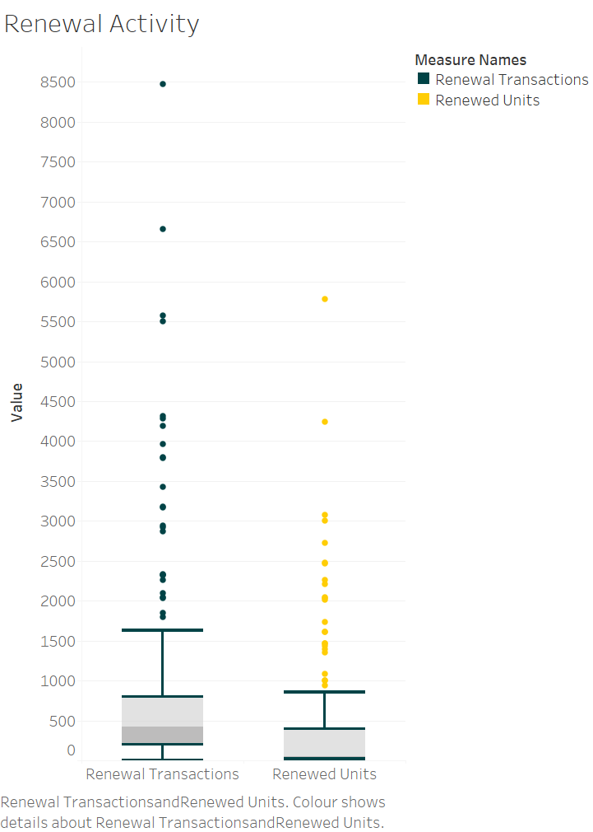
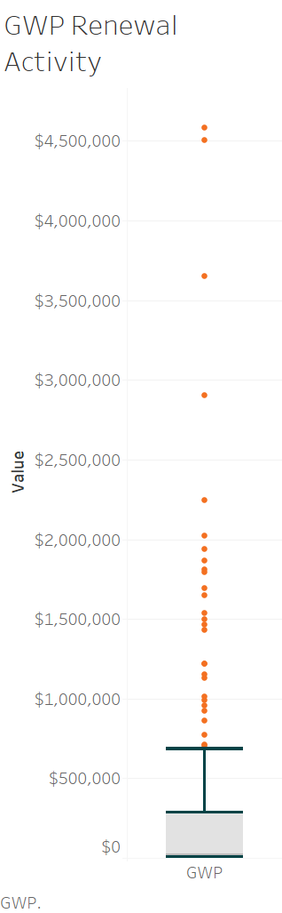
Insight 1
GWP, renewal transactions and renewal units all have a positively skewed distribution.
There is high variance in all plots, as values are majority low but instances of higher vales.
The plots show several outliers especially for GWP and renewal transactions. This suggests that there are some policies with very high values that are affecting the overall distribution of the data.

Slide 7
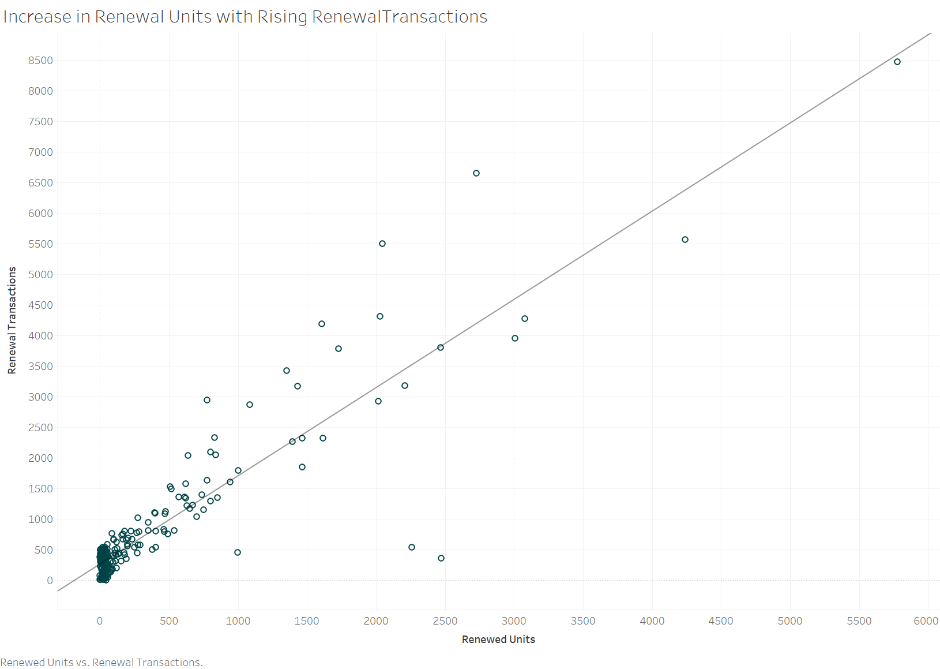
Insight 2
There appears to be an increase om renewal units, with rising renewal transactions. It can be inferred the more renewal transactions that occur, the more likely a unit (policy) renews.
A correlation analysis also showed an almost perfect relationship between renewal units and renewal transactions (0.9), meaning there are moving together.

Slide 8
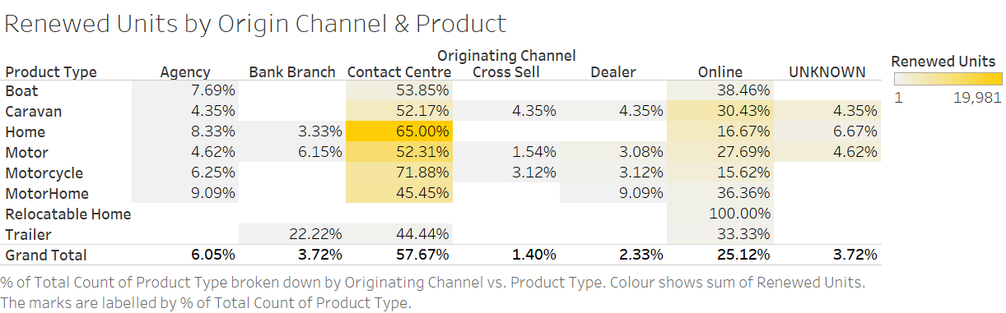
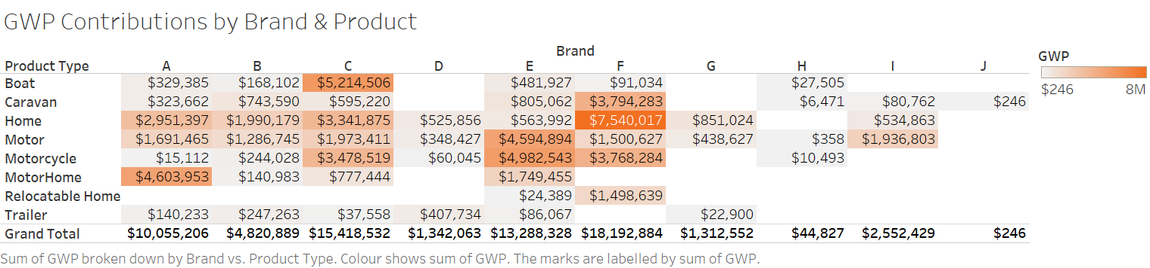
Insight 3
The main method of renewal activity is via the contact centre, with Home making up majority of renewed units. Secondly, all product types appears to have a high online presence.
Cross selling, dealer, and brank branch renewed the least number of product units.
Its clear that customers prefer certain channels when renewing products.
Brand E appears to service all products, however brand F has the largest GWP. Home, boat, motorhome, motor and motorcycle has made the largest GWP contributions to the company.
Brand J, H and I has lowest GWP. This could mean these brands may not offer all products, hence the lower GWP.

Slide 9
Predictive Modelling
Correlations
Values | Renewal Transaction | Renewed Units | GWP
Renewal Transaction | 1
Renewed Units | 0.903761551 | 1
GWP | 0.71098649 | 0.720714909 | 1
Renewed Units and Renewal transactions have an almost perfect correlation of 0.9 GWP has a stronger correlation with renewed units (0.72), as appose to renewal transaction (0.71).
 | Coefficients | P-value
Intercept | 68166.99366 | 0.058550486
RENEWED UNITS | 655.7326359 | 9.65414E-36
The R Square means 52% of the variance of the GWP can be explained by the renewed units. The model is confident in the findings as the P-value is well below 0.05. This means the remaining 48% of the variability is not explained by the model, but due to other factors. A larger & diverse dataset is required to propose business recommendations.
Regression Statistics
R Square | 0.51942998
Notes:
Evaluate the assumptions behind linear regression and discuss any deviations:
Its important to note that this model is breaking the assumptions on linear regression. GWP and renewed units do not follow a normal distribution and is heavily skewed.
Renewal transaction and renewed units, are highly correlated almost perfect, so including these two into the predictive model to determine GWP would be redundant, and lack the ability to distinguish between individual effects.
Residual also do not follow a normal distribution

Slide 10
Summary and call to action
Preliminary findings of the five- day insurance renewal snapshot indicate there is more work to be done on data analysis. However additional opportunities have been identified to implement a strategic plan; promote digital adoption, focus on customer conversations & frequent digital communications.
A larger sample and diverse dataset is required to validate findings
Claims data, complaints information, customer NPS, customer demographics and detailed policy information, competitor behaviour
Enhance & promote digital renewal platforms
Awareness and simplification of the online renewal process may attract more users due to its convenience, as seen in customer trends
Prioritize customer conversations
Invest into outbound calling to drive renewal communications, and personalise renewal conversations – these transactions appear to have a strong influence on the decision to renew
Frequent digital communications
Implement an automated system for sending out personalised renewal reminders more frequently
Early and frequent reminders may prevent lapses in coverage and increase the likelihood of renewals which impact GWP

Slide 11
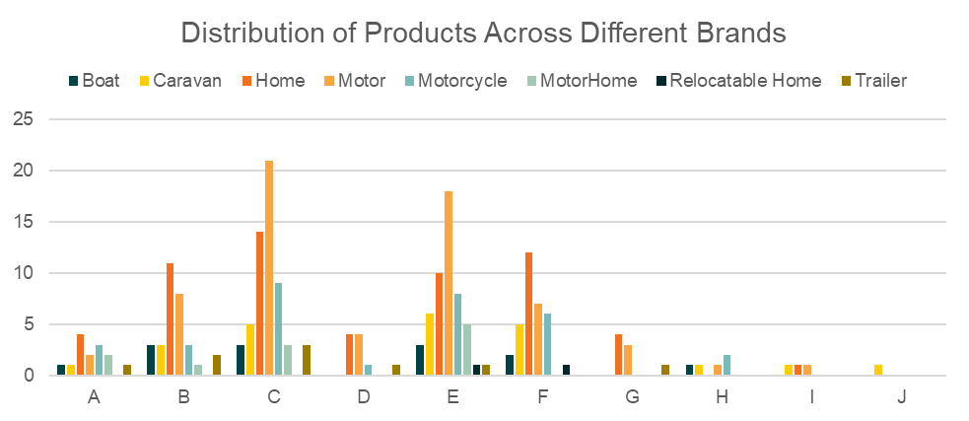
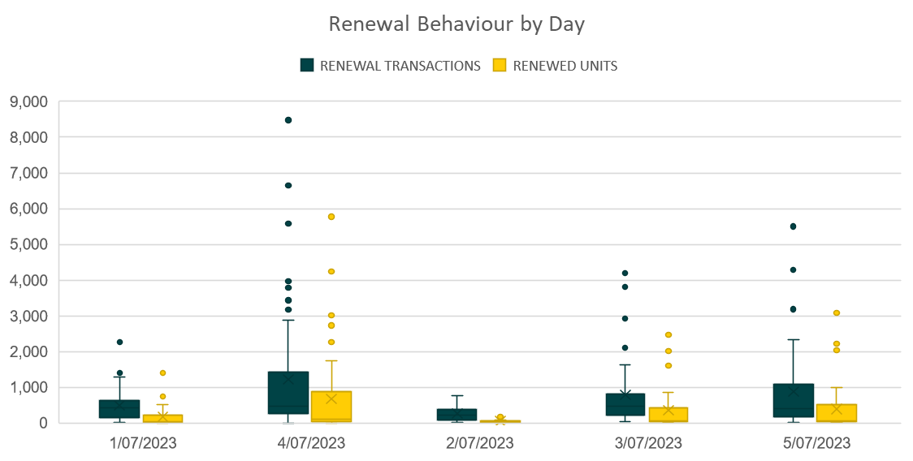
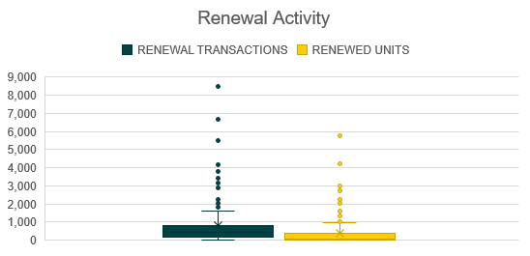
Appendix

Slide 12
Appendix 2

Slide 13
Appendix 3

